Slide 1

Hemant Kailash Agrawal Khushi Doshi Krutika Patel Savan Patel Yash Tailor Dhrumil Prajapati
Airbnb Listings Analysis

Slide 2
Introduction
This project aims to analyze Airbnb listings across several major US cities to uncover trends and insights related to pricing, reviews, and availability.
This analysis's main goal is to give a thorough look at important data and patterns related to Airbnb listings in a number of significant cities. This dashboard provides useful information to assist tourists in making decisions.

Slide 3

Data Selection Process
The data was selected based on relevance to common Airbnb metrics such as pricing, reviews, and availability.
Only listings with complete information on price, reviews, and availability were included to ensure accuracy.
The datasets were obtained from publicly available Airbnb data repositories for each city.

Slide 4
Data Points and Questions
Key metrics include average price, number of reviews, room type distribution, and availability.
Questions:
Pricing: What are the pricing trends across different cities and room types?
Reviews: How do review patterns vary by month and room type?
Availability: What is the availability rate across different cities?

Slide 5
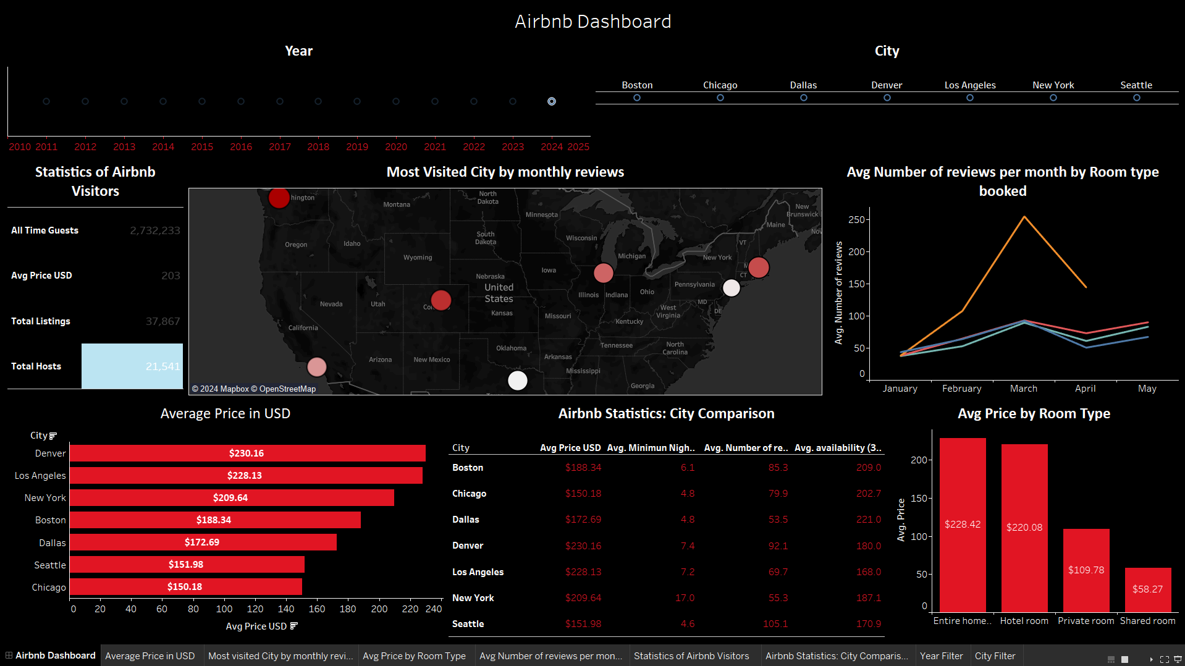
Dashboard Overview
Key Components:
Statistics of Airbnb Visitors for overall metrics.
Most Visited City by Monthly Reviews for popularity analysis.
Average Price in USD by City for price comparisons.
Average Number of monthly Reviews by Room Type to see seasonal trends.
Average Price by Room Type to better understand the prices.
City Comparison Statistics for a detailed city-by-city analysis.

Slide 6
Key Considerations
Designed the dashboard to tell a story, guiding tourists through key insights step-by-step.
Highlighted popular destinations and trends to assist in travel planning.
Provided comparative data (e.g., average prices by city and room type) to help tourists make informed decisions.
Included city-specific statistics for targeted insights.

Slide 7
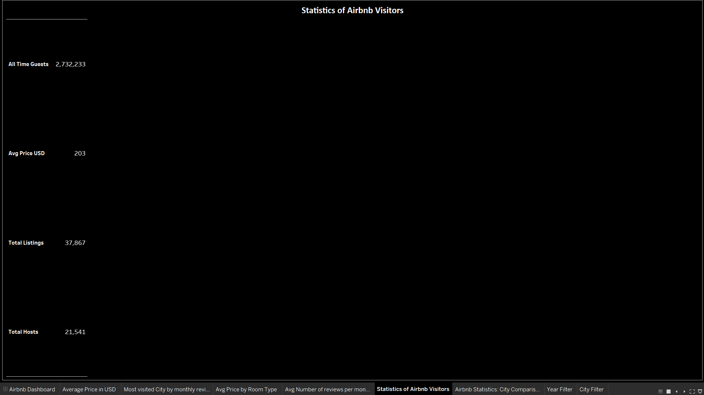
Statistics of Airbnb Visitors
These statistics give an overview of the scale and average pricing of Airbnb listings across the selected cities.

Slide 8
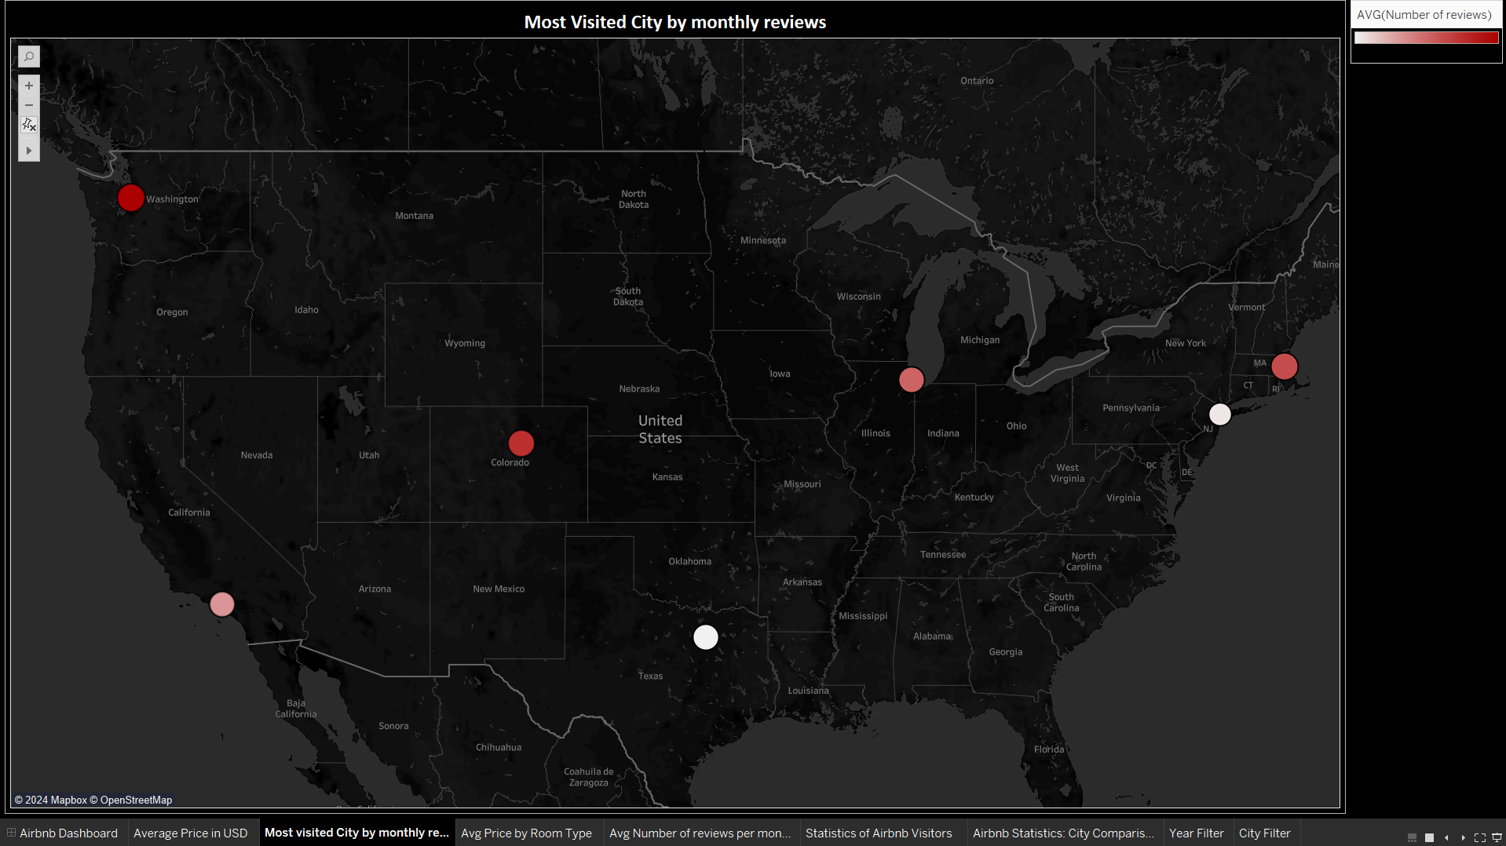
Most Visited City by Monthly Reviews
This map shows cities with the most monthly Airbnb reviews using colored markers.
Marker size represents review volume, highlighting popular cities for Airbnb stays.
Larger circles mean higher review counts, indicating the most visited cities.

Slide 9
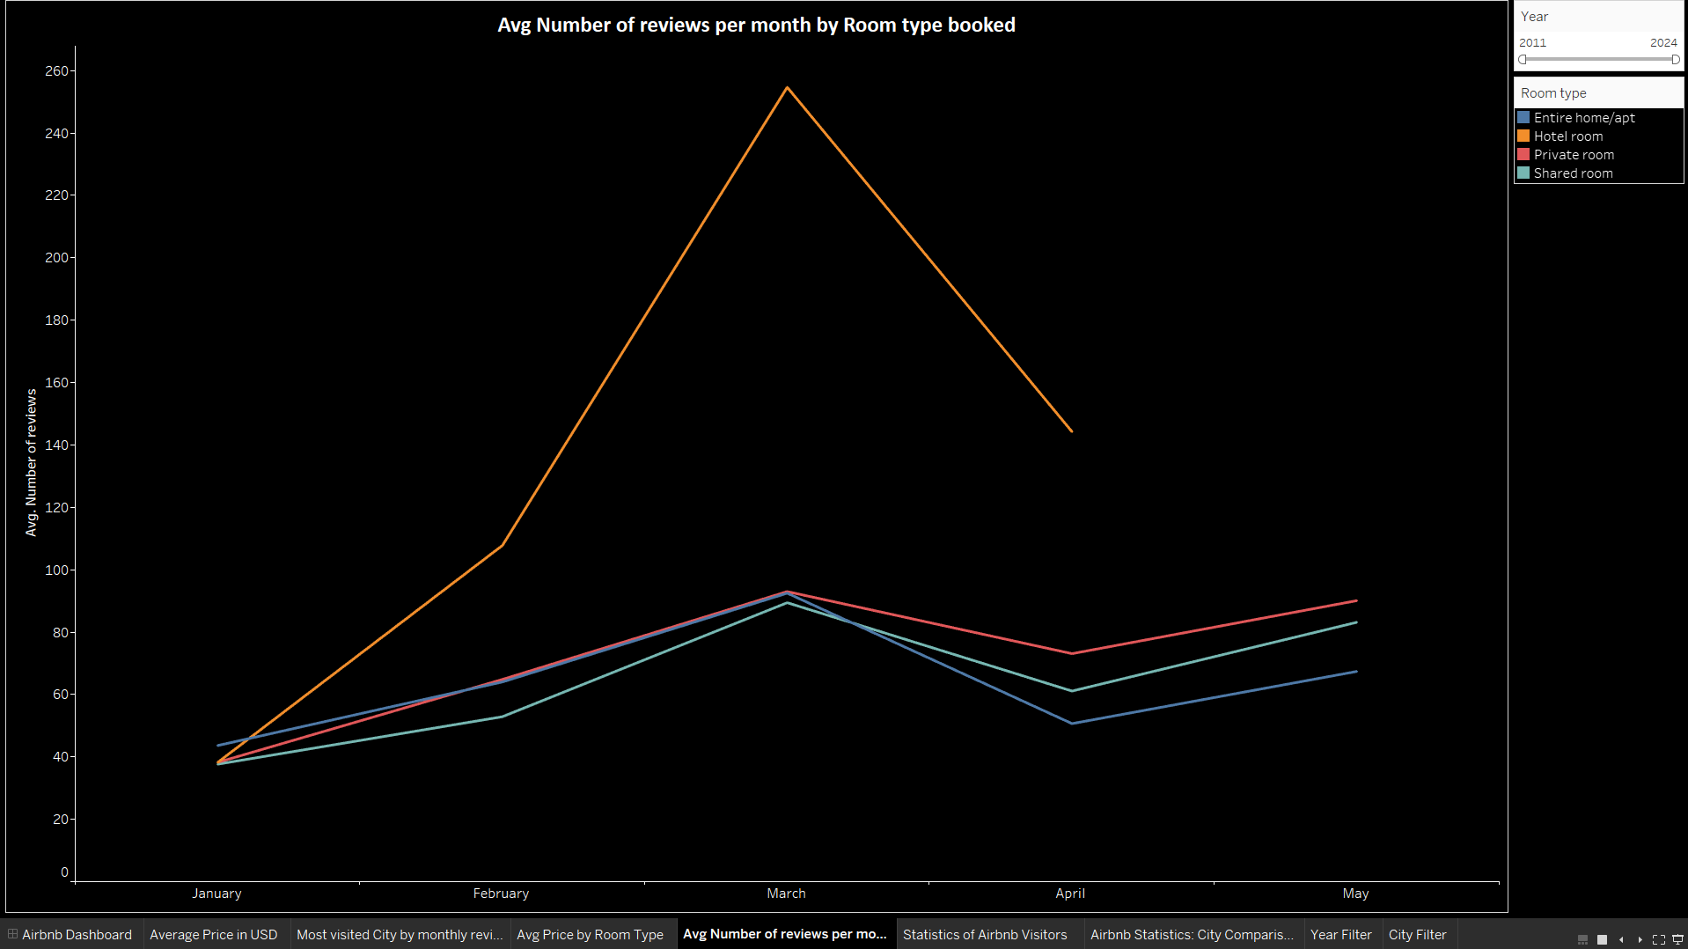
Average Number of Reviews per Month by Room Type
This line graph shows average monthly reviews for different room types.
It highlights trends and seasonality in room popularity.
For example, a March peak indicates a seasonal rise in bookings.

Slide 10
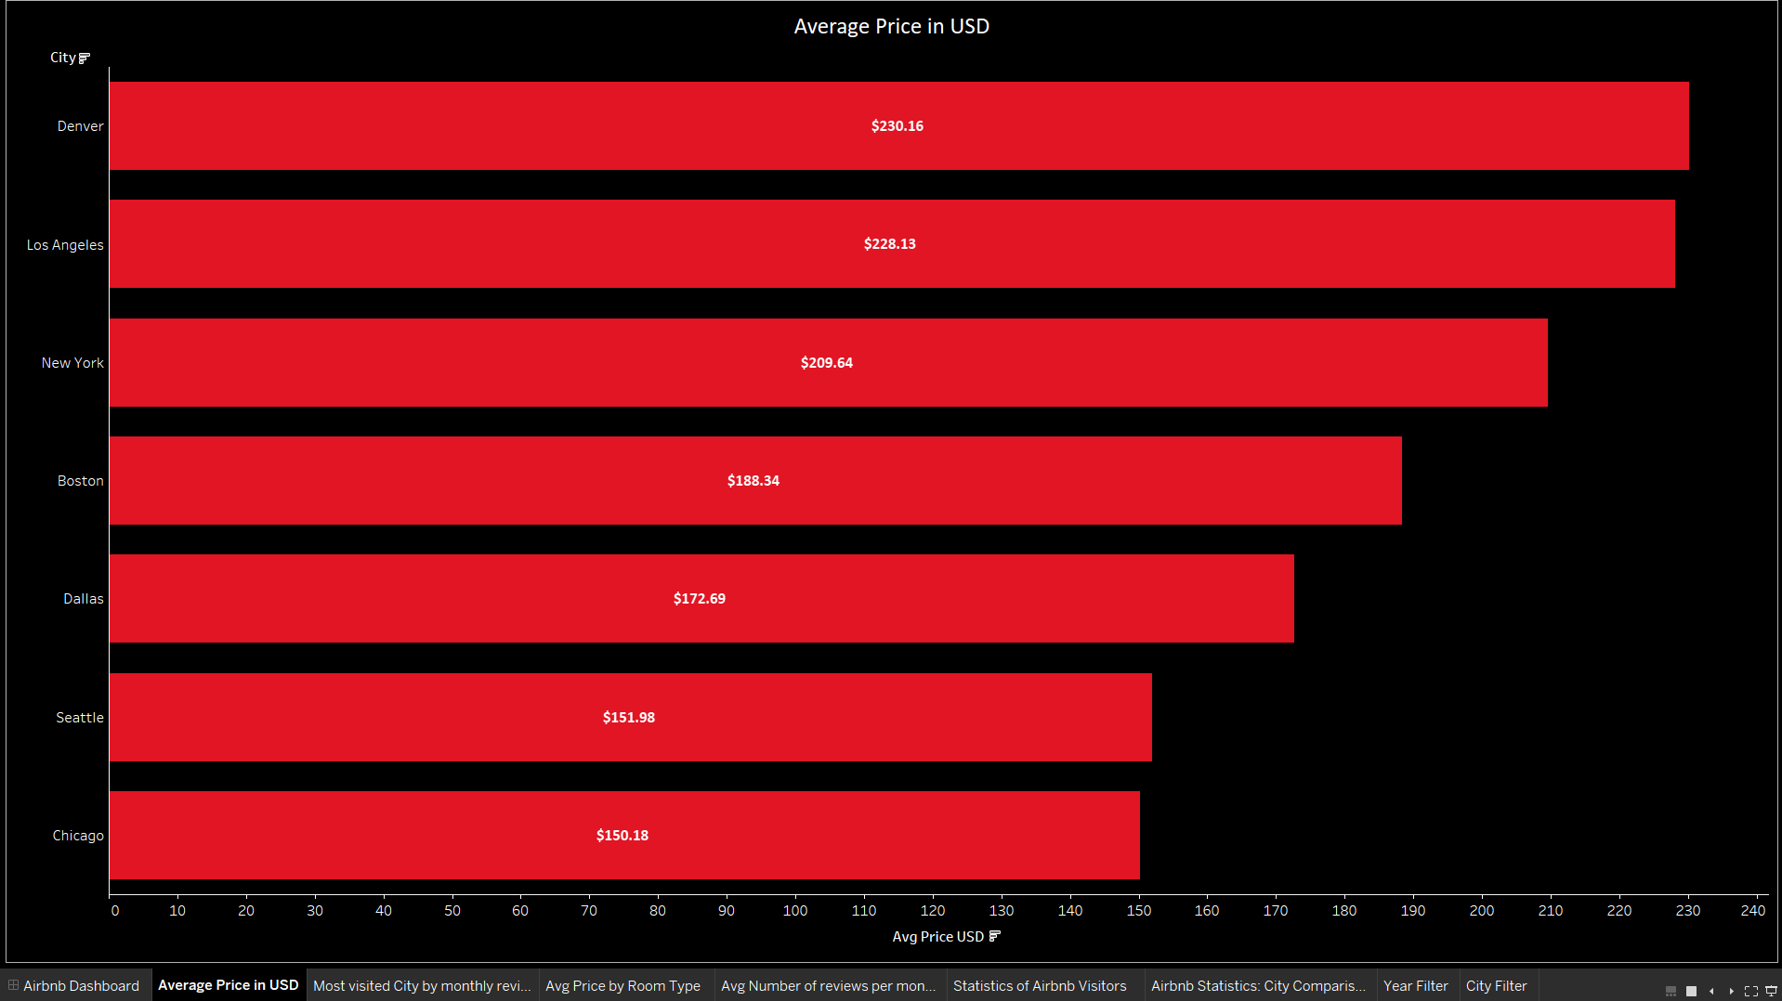
Average Price in USD by City
This bar chart shows the average Airbnb prices in selected cities.
It highlights cities with the highest and lowest average prices, useful for market comparison and pricing strategies.
Denver ($230.16) and Los Angeles ($228.13) have the highest prices, while Chicago ($150.18) has the lowest.

Slide 11
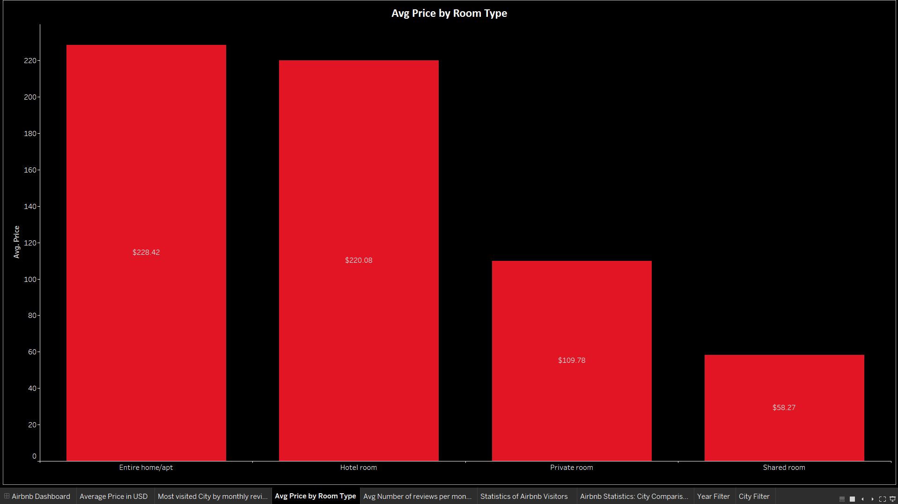
Average Price by Room Type
This bar chart shows the average price for different room types.
It illustrates the pricing distribution based on accommodation type.
Entire homes and hotel rooms are the most expensive; shared rooms are the cheapest.

Slide 12
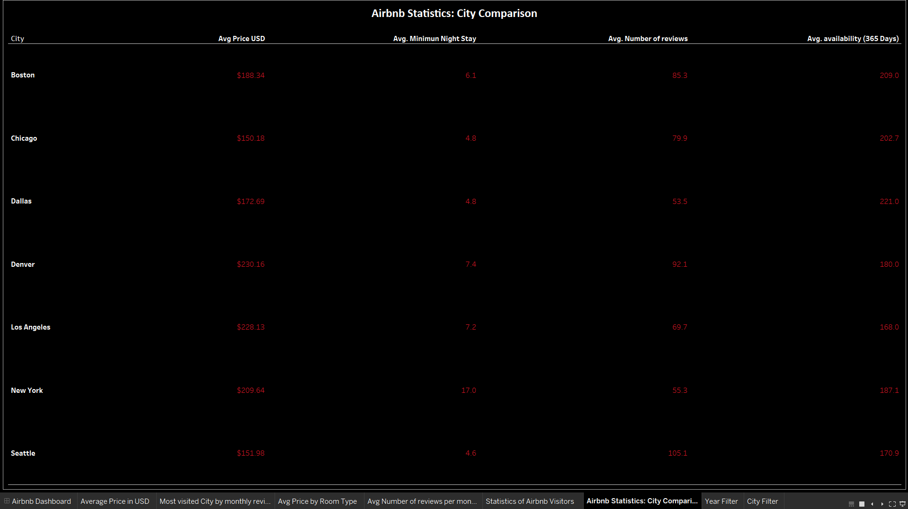
Airbnb Statistics: City Comparison
It offers a comprehensive view of key statistics, allowing for detailed city-by-city analysis.

Slide 13
Key Insights for Tourists
Most Visited Cities by Monthly Reviews
Top Cities:
Seattle
Denver
Boston
Why Visit?:
Popular, highly-rated destinations
Plenty of activities and attractions
Vibrant city life and cultural events
Average Prices:
Denver: $230.16
Los Angeles: $228.13
New York: $209.64
Boston: $188.34
Dallas: $172.69
Seattle: $151.98
Chicago: $150.18

Slide 14
Average Price in USD by City
Recommendations:
For budget-friendly options:
Chicago: $150.18
Seattle: $151.98
For vibrant, high-end experiences:
Denver: $230.16
Los Angeles: $228.13
Average Price by Room Type
Prices by Type:
Entire Home/Apt: $228.42
Hotel Room: $220.08
Private Room: $109.78
Shared Room: $58.27

Slide 15
Average Price by Room Type
Recommendations:
Entire homes and hotel rooms:
Provide more amenities
Suitable for families and luxury travelers
Private rooms and shared rooms:
Budget-friendly options
Ideal for solo travelers or budget-conscious tourists
Average Number of Reviews per Month by Room Type
Seasonal Trends:
Peak in reviews in March
Recommendations:
Plan trips during off-peak months (January, February)
Secure better deals and less crowded accommodations

Slide 16
City Comparison Statistics
Metrics Compared:
Average prices
Minimum night stays
Number of reviews
Recommendations:
Compare cities based on preferences for length of stay, budget, and review ratings
For shorter minimum stays:
Chicago: 4.8 nights
Dallas: 4.8 nights

Slide 17
Travel Tips and Recommendations
Best Cities for Affordable Stays
Affordable Options:
Chicago: $150.18
Seattle: $151.98
Vibrant Experiences:
Los Angeles: $228.13
Denver: $230.16
Seasonal Travel Planning
Recommendations:
Plan trips during off-peak seasons:
January
February
Avoid high demand in March for better deals and less crowded stays

Slide 18
Accommodation Selection
Luxury and Comfort:
Entire homes and hotel rooms:
Offer more amenities
Provide more space and privacy
Budget Travel:
Private rooms and shared rooms:
Cost-effective choices
Shared rooms are the most economical, perfect for solo travelers
Final Thoughts
Goal: Assist tourists in finding the best Airbnb options
Key Factors:
Understand pricing trends, review patterns, and availability
Make informed decisions to enhance travel experience
Outcome: Tailored recommendations based on preferences and budget

Slide 19
Conclusion
Most Visited Cities: Seattle, Denver, and Boston are popular and highly-rated destinations with vibrant attractions.
Affordable Stays: Chicago ($150.18) and Seattle ($151.98) offer the lowest average Airbnb prices.
High-End Experiences: Denver ($230.16) and Los Angeles ($228.13) are ideal for those seeking vibrant, upscale stays.
Room Type Pricing: Entire homes and hotel rooms are the most expensive, while shared rooms are the most economical.
Seasonal Trends: Reviews peak in March; plan trips in January and February for better deals.
City Comparisons: Chicago and Dallas offer shorter minimum stays (4.8 nights), suitable for flexible travel plans.
Travel Tips: For luxury, choose entire homes or hotel rooms; for budget, opt for private or shared rooms.

Slide 20

Questions and Answers

